Slide 1
Module 4: Software Vulnerabilities
CYBR 515: Software Security
Summer 2024
Mohammad Jamil Ahmad, Ph.D.

Slide 2
Table of Contents
Injection attacks
Broken authentication and session management
Request forgery
Language-specific defenses
Example of enterprise web defenses
Tools for vulnerability detection in source code repositories

Slide 3
Web Application Vulnerabilities
Definition: Web application vulnerabilities are weaknesses in the security of web applications that can be exploited by attackers.
Consequences: Data breaches, unauthorized access, code execution.
Focus Topics:
Injection attacks
Broken authentication and session management
Request forgery
Language-specific defenses
Enterprise web defenses

Slide 4
1. Injection Attacks Overview
Definition: Malicious attempts to inject unauthorized code or commands.
Common Types:
SQL Injection (SQLi)
Cross-Site Scripting (XSS)
Command Injection
Lightweight Directory Access Protocol (LDAP) Injection
XPath Injection
Real-world Example: ResumeLooters stole data from 2 million job seekers using SQLi and XSS.

Slide 5
1.A. SQL Injection (SQLi)
Definition: Attackers inject malicious SQL statements into input fields.
Impact: Unauthorized access, data disclosure, data manipulation.
Example: Injecting ' OR '1'='1' -- into a login field to bypass authentication.
Detection Tools:
SQLMap
Burp Suite
Bandit

Slide 6
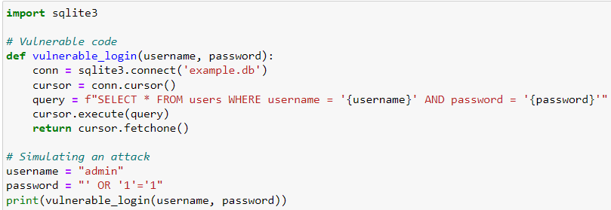
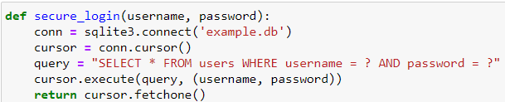
SQLi example
Vulnerable code
Fix: Use parameterized queries

Slide 7
1.B. Cross-Site Scripting (XSS)
Definition: Malicious scripts (JavaScript) injected into web pages.
Impact: Data theft, session hijacking, website defacement.
Example: Injecting <script>alert('XSS');</script> into a comment field.
Detection Tools:
OWASP ZAP
XSS Me

Slide 8
1.C. Command Injection
Definition: Malicious commands injected into input fields executed by the system.
Impact: Unauthorized access, remote code execution.
Example: Injecting ; ls into a file input field.
Detection Tools:
Burp Suite
Veracode

Slide 9
1.D. LDAP Injection
Definition: Malicious LDAP statements injected to manipulate authentication processes.
Impact: Unauthorized access, data disclosure.
Example: Injecting *)(uid=*))(|(uid=* into an LDAP search filter to bypass authentication.
Detection Tools:
OWASP ZAP
LDAPSoft

Slide 10
1.E. XPath Injection
Definition: Malicious XPath queries injected to manipulate XML data retrieval.
Impact: Unauthorized access, data disclosure.
Example: Injecting ') or '1'='1 into an XPath query to bypass authentication.
Detection Tools:
Burp Suite
OWASP ZAP

Slide 11
Mitigating the risks of injection attacks
Parameterized statements
Input validation and sanitization
Least privilege principle:
Web Application Firewalls (WAFs)
Regular security audits
Security headers

Slide 12
1. Parameterized statements
Parameterized statements (or prepared statements) are a way of structuring SQL queries so that input data is treated as a parameter rather than part of the SQL command itself. This helps prevent SQL injection attacks by separating the code from the data.

Slide 13
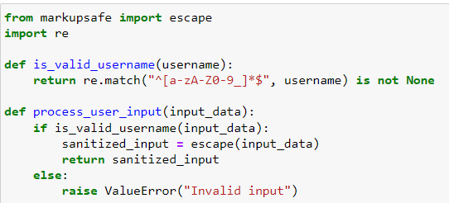
2. Input Validation and Sanitization
Input validation ensures that user input is in the expected format and meets specific criteria before processing. Sanitization cleans user input to remove or encode any potentially harmful characters.
How to Implement:
In Python, use libraries such as validators or custom validation functions.

Slide 14
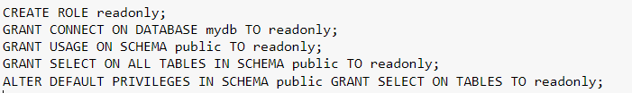
3. Least Privilege Principle
The least privilege principle restricts access rights for users and applications to only what is necessary to perform their functions, reducing the risk of unauthorized access or modifications.
How to Implement:
Configure database user roles with minimal permissions.

Slide 15
4. Web Application Firewalls (WAFs)
A Web Application Firewall (WAF) is a security system that monitors, filters, and blocks HTTP traffic to and from a web application, protecting it from various attacks, including SQL injection and XSS.
How to Implement:
Use a WAF service like AWS WAF or Cloudflare WAF.
Example: Setting up AWS WAF:
Create a Web ACL in AWS WAF.
Add rules to the Web ACL to block or allow traffic based on conditions like IP addresses, query strings, and request size.
Associate the Web ACL with an AWS resource such as an Amazon CloudFront distribution or an Application Load Balancer.

Slide 16
5. Regular Security Audits
Regular security audits involve systematically reviewing and assessing the security of an application or system to identify and address vulnerabilities.
How to Implement:
Use automated tools like OWASP ZAP or manual penetration testing.

Slide 17
6. Security Headers
Security headers are a key part of securing web applications. They instruct web browsers on how to handle content, mitigate various types of attacks, and enforce security policies.
Security headers are HTTP response headers that help enhance the security of web applications by instructing browsers on how to behave when handling your site’s content.
Content Security Policy (CSP):
X-Content-Type-Options:
X-Frame-Options
X-XSS-Protection
HTTP Strict Transport Security (HSTS)
Referrer-Policy:
Cross-Origin Resource Sharing (CORS).
Feature Policy
HTTP Public Key Pinning (HPKP)
Incident response plan

Slide 18
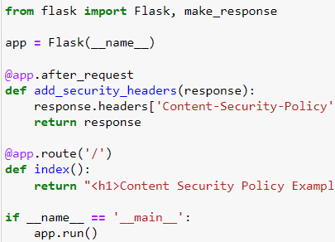
6.A. Content Security Policy (CSP)
Content Security Policy (CSP) allows you to define a whitelist of trusted content sources such as scripts, stylesheets, images, and fonts. This helps prevent XSS attacks by restricting the sources from which content can be loaded.

Slide 19

6.B. X-Content-Type-Options
The X-Content-Type-Options header set to nosniff instructs browsers not to override the detected MIME type of a resource, helping prevent MIME-sniffing attacks.

Slide 20

6.C. X-Frame-Options
The X-Frame-Options header can be set to DENY or SAMEORIGIN to prevent clickjacking attacks by specifying whether a browser should be allowed to render a page in a frame or iframe.

Slide 21

6.D. X-XSS-Protection
The X-XSS-Protection header enables the browser's built-in XSS protection mechanisms, which can help detect and mitigate XSS attacks.

Slide 22

6.E. HTTP Strict Transport Security (HSTS)
HTTP Strict Transport Security (HSTS) instructs browsers to only access a website over HTTPS, preventing man-in-the-middle attacks and protocol downgrade attacks.

Slide 23

6.F. Referrer-Policy
The Referrer-Policy header controls how much referrer information is included in requests, helping to prevent information leakage.

Slide 24
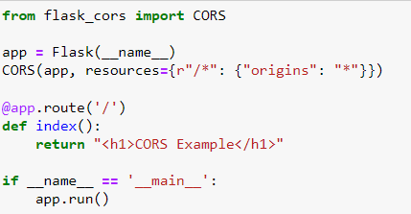
6.G. Cross-Origin Resource Sharing (CORS)
Cross-Origin Resource Sharing (CORS) headers control which domains can access resources on your server, mitigating unauthorized cross-origin req uests such as CSRF.

Slide 25

6.H. Feature Policy
Feature Policy allows you to selectively enable, disable, or restrict browser features and APIs, mitigating various attacks and vulnerabilities.

Slide 26
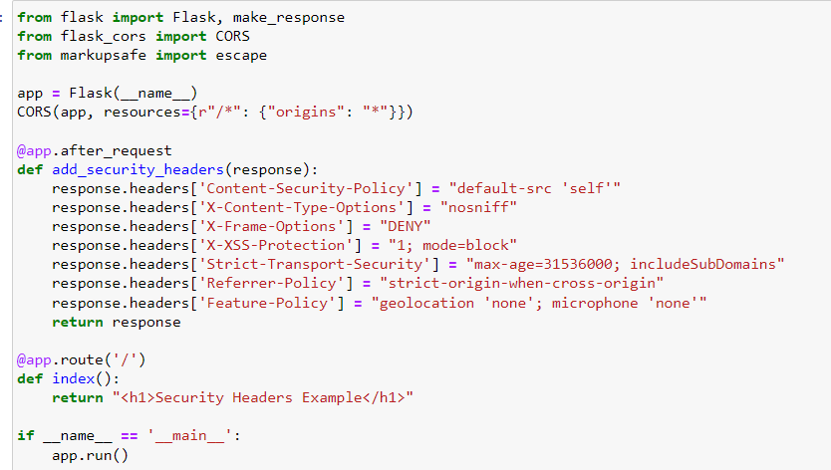
Example Flask Application with All Security Headers

Slide 27
How to Detect and Verify Security Headers
Using Tools:
Security Headers.com: A free online tool to test the HTTP response headers of your website.
OWASP ZAP: An open-source web application security scanner to verify if security headers are correctly implemented.
Testing with SecurityHeaders.com:
Deploy your Flask application.
Visit SecurityHeaders.com.
Enter your web application's URL and click "Scan".
Review the results to ensure all headers are correctly implemented.

Slide 28
2. Broken authentication and session management
Definition: Security vulnerabilities that lead to unauthorized access and identity theft.
Impact: Can result in major security breaches, such as the Equifax data breach of 2017, exposing sensitive information of 147 million consumers.
Example Incident:
Equifax Data Breach (2017): A well-known example of broken authentication leading to a massive data breach.

Slide 29
What is Broken Authentication?
Definition: Occurs when attackers exploit flaws in the authentication process to gain unauthorized access to user accounts.
Common Issues:
Weak password policies:
Lack of complexity requirements.
No enforcement of strong password policies.
Credential stuffing:
Attackers use leaked username-password pairs from one service to access another service.
Insecure session management:
Poorly managed user sessions, leading to session fixation or hijacking.

Slide 30
How to Fix Broken Authentication
Mitigation Measures:
Enforce strong password policies.
Use Multi-Factor Authentication (MFA).
Protect against credential stuffing by monitoring and blocking suspicious login attempts.

Slide 31
Session Management
Definition: Secure creation, maintenance, and termination of user sessions after authentication.
Common Issues:
Session fixation: Attackers set or hijack a user’s session ID.
Session timeout: Lack of proper session timeout policies.
Session invalidation: Inability to properly invalidate or destroy sessions.

Slide 32
How to Fix Session Management
Mitigation Measures:
Use secure session management practices, including encryption and secure cookie attributes.
Implement session timeout to log out inactive users.
Generate random and unique session identifiers.
Invalidate or regenerate session IDs upon login or privilege changes.

Slide 33
Token-Based Authentication
Definition: Uses tokens such as JSON Web Tokens (JWTs) for enhanced security.

Slide 34
Regular Security Audits and Compliance
Importance: Regular audits and penetration testing to identify and address vulnerabilities.
Compliance: Ensure adherence to security standards such as PCI DSS.

Slide 35
Education and Training
Importance: Raise awareness among developers about secure authentication and session management practices.
Regular Training: Keep developers updated on the latest security threats and best practices.

Slide 36
3. Request Forgery
Introduction to Cross-Site Request Forgery (CSRF)
Definition: A web security vulnerability where an attacker tricks a user's browser into performing an unwanted action on a trusted site where the user is authenticated.
Impact: Can lead to unauthorized actions such as changing account settings or making purchases.
Example Incident:
Samy Worm (2008): A CSRF attack on the WordPress blogging application created by Samy Kamkar.

Slide 37
CSRF Attack Scenario
Setup: An attacker tricks a user into loading a page with a malicious request.
Execution: The request is sent to a target site where the user is authenticated.
Session Exploitation: The browser includes the user’s session cookie, making the request appear legitimate.
Unintended Action: The target site processes the malicious request, leading to unintended actions.

Slide 38
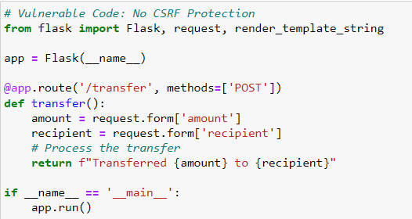
Example of Vulnerable Code (CSRF)
Vulnerability: This example lacks protection against CSRF, allowing unauthorized requests.
Detection Tools:
OWASP ZAP: Can be used to scan for CSRF vulnerabilities.

Slide 39
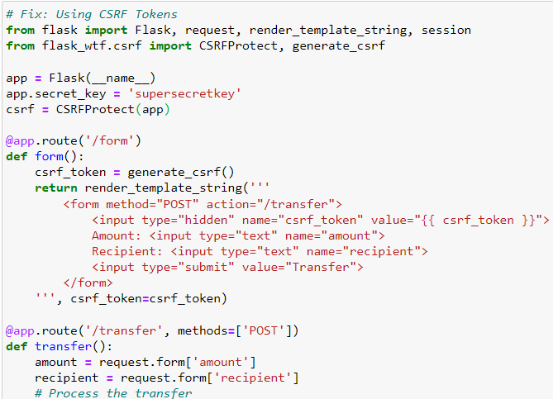
How to Fix CSRF
Fixing CSRF with Anti-CSRF Tokens: Mitigation Measures:
Use anti-CSRF tokens in forms and requests.
Set SameSite attribute on cookies.
Check the Referer header on incoming requests.
Include custom headers in requests.

Slide 40
Preventive Measures Against CSRF
Anti-CSRF Tokens:
Unique tokens included in forms and requests to validate legitimacy.
SameSite Cookie Attribute:
Controls when cookies are sent with cross-site requests.
Referer Header Checking:
Ensures requests originate from the same domain.
Custom Headers:
Used in requests to validate their legitimacy.
Double-Submit Cookies:
Token stored in both cookie and request parameter for verification.
Content-Type Validation:
Ensures correct Content-Type header in requests.

Slide 41
Implementing Best Practices
Secure Coding Practices: Avoid introducing vulnerabilities that CSRF attacks could exploit.
Session Management: Implement secure session management practices, including session timeout and secure session token generation.
Security Audits: Regularly conduct security audits and penetration testing.
Education and Training: Provide training for developers on secure coding practices and CSRF prevention.

Slide 42
4. Language-Specific Defenses
Definition: Security measures tailored to the programming language used in web applications.
Importance: Protects against common web attacks like SQL injection, XSS, and CSRF by leveraging language-specific tools and practices.
PHP Defenses
Java Defenses
Python Defenses
Node.js (JavaScript)
Ruby (Ruby on Rails)

Slide 43
PHP Defenses: Filter Input Data
Filter Input Data: Clean up what users type into the website to remove harmful stuff.
Example:
Before: Accepting any input without checking.
After: Using filter_input() to clean the input.
Use functions like filter_input() or mysqli_real_escape_string() to sanitize user input.

Slide 44

PHP Defenses: Prepared Statements
Use a safe way to handle database queries to prevent attacks.
Example:

Slide 45
PHP Defenses: Cross-Site Scripting (XSS) Prevention
Prevent harmful scripts from running on your website.
Example:
echo htmlspecialchars($user_input, ENT_QUOTES, 'UTF-8');

Slide 46
PHP Defenses: Session Security
Keep user sessions secure by using strong session handling practices.
Example:
session_start();session_regenerate_id(true); htmlspecialchars($user_input, ENT_QUOTES, 'UTF-8');

Slide 47
PHP Defenses: Content Security Policy (CSP)
Control which resources (like scripts and images) can be loaded to prevent attacks.
Example:
header("Content-Security-Policy: default-src 'self'");

Slide 48
Java Defenses: Input Validation
Check and clean user input to prevent harmful data.
Example:
String username = request.getParameter("username");
if (username != null && !username.matches("[A-Za-z0-9_]+")) {
throw new IllegalArgumentException("Invalid username");
}

Slide 49
Java Defenses: Hibernate ORM
Use a safe method for database interactions.
Example:
Query query = session.createQuery("from User where username = :username");
query.setParameter("username", username);

Slide 50
Java Defenses: Anti-CSRF Tokens
Use unique codes to ensure requests are legitimate.
Example:
@Controller
public class FormController {
@GetMapping("/form")
public String showForm(Model model) { model.addAttribute("csrfToken", generateCsrfToken()); return "form";
}}

Slide 51
Java Defenses: Security Headers
Use headers to enhance security.
Example:
@RestController
public class SecurityController {
@GetMapping("/secure")
public ResponseEntity<String> secure() {
HttpHeaders headers = new HttpHeaders();
headers.add("Strict-Transport-Security", "max-age=31536000; includeSubDomains");
return new ResponseEntity<>("Secure Content", headers, HttpStatus.OK);
} }

Slide 52
Rest of examples are shown in the book

Slide 53
PMD for static analysis
PMD: An open-source static analysis tool that scans Java and other languages for potential bugs, code smells, and security vulnerabilities. It provides customizable rulesets and integrates with various IDEs and build tools.
Manual is posted on eCampus.

Slide 54
PMD key features
Detects Common Code Issues:
Finds bugs, dead code, suboptimal code practices, duplicate code, and possible performance issues.
Identifies potential security vulnerabilities.
Multi-Language Support:
Primarily supports Java but also supports JavaScript, XML, XSL, PLSQL, Apache Velocity, and others.
Customizable Rulesets:
Users can create custom rulesets tailored to their specific needs.
PMD includes a large number of predefined rules for various coding standards and best practices.

Slide 55
PMD key features
Integrations:
Integrates with various IDEs (e.g., Eclipse, IntelliJ IDEA, NetBeans).
Supports build tools like Maven, Gradle, and Ant.
Can be used in CI/CD pipelines to ensure code quality during the development process.
Detailed Reports:
Generates detailed reports in various formats (HTML, XML, CSV, text) highlighting identified issues and providing suggestions for remediation.

Slide 56
OWASP Dependency-Check
An open-source tool that helps identify project dependencies with known vulnerabilities.
It is part of the OWASP (Open Web Application Security Project) suite of security tools. Dependency-Check is particularly useful for ensuring that the libraries and frameworks your project relies on do not introduce security risks.

Slide 57
OWASP Dependency-Check key features
Vulnerability Identification:
Detects vulnerabilities in third-party libraries and frameworks used in your project.
Utilizes databases like the NVD, NPM Audit, Retire.js, and OSS Index to identify known vulnerabilities.
Multi-Language Support:
Supports a wide range of programming languages and package managers, including Java (Maven, Gradle), .NET (NuGet), JavaScript (npm, Yarn), Python (Pip), Ruby (Bundler), PHP (Composer), and more.

Slide 58
OWASP Dependency-Check key features
Integration:
Easily integrates with CI/CD pipelines and build tools like Jenkins, Maven, Gradle, and others.
Provides plugins and CLI tools for different development environments.
Detailed Reports:
Generates detailed reports highlighting the vulnerabilities, their severity, and recommendations for remediation.
Supports various report formats, including HTML, XML, JSON, and CSV.

Slide 59
Bandit
Bandit is an open-source security linter for Python code. Developed by the OpenStack Security Project, Bandit analyzes Python programs to find common security issues. It inspects the abstract syntax tree (AST) of each Python file to identify potential vulnerabilities and coding mistakes.
Key Features of Bandit:

Slide 60
Banidt Features
Security Checks: Bandit includes a wide range of security checks to identify common issues such as:
Hardcoded passwords
Use of weak cryptographic methods
Potential command injection vulnerabilities
Insecure use of functions like eval
Insecure handling of user input

Slide 61
Banidt Features
Customizability: Users can configure Bandit to include or exclude specific tests, define severity levels, and customize output formats.
Integration: Bandit can be easily integrated into CI/CD pipelines to automatically scan code during development and deployment processes.
Detailed Reports: Generates detailed reports highlighting the severity and location of identified issues, along with suggestions for remediation

Slide 62
Snyk
Snyk is a developer-first security platform that helps organizations find and fix vulnerabilities in their code, dependencies, container images, and infrastructure as code (IaC).
Snyk integrates seamlessly into the development workflow, enabling developers to secure their applications from the start and continuously throughout the software development lifecycle

Slide 63
Snyk features
Vulnerability Scanning:
Scans for vulnerabilities in open-source dependencies, container images, and IaC configurations.
Provides detailed information about identified vulnerabilities, including severity, exploitability, and potential impact.
Automated Fixes:
Suggests and automates the application of patches and upgrades to fix identified vulnerabilities.
Provides pull requests with fixes directly to your version control system (VCS).
Developer-Friendly Integration:
Integrates with popular development tools, IDEs, CI/CD pipelines, and VCS platforms such as GitHub, GitLab, Bitbucket, and Azure Repos.
Supports multiple programming languages and package managers, including JavaScript (npm, Yarn), Python (pip), Java (Maven, Gradle), Ruby (Bundler), and more.

Slide 64
Snyk Featuyers
License Compliance:
Checks for license compliance issues in open-source dependencies.
Helps ensure that all dependencies meet organizational licensing policies.
Infrastructure as Code (IaC) Security:
Scans IaC configurations (like Terraform and CloudFormation) for security issues.
Provides best practices for securing infrastructure configurations.
Container Security:
Scans container images for vulnerabilities and provides actionable insights to secure containerized applications.
Integrates with container registries and CI/CD pipelines to ensure secure image deployment.

Slide 65
Comparison of tools
Criteria | PMD | OWASP Dependency-Check | Bandit | Snyk
Primary Function | Static code analysis | Vulnerability scanning in dependencies | Security linter for Python code | Comprehensive security platform
Supported Languages | Java, JavaScript, XML, XSL, PLSQL, Apache Velocity, and more | Java, .NET, JavaScript, Python, Ruby, PHP, and more | Python | Java, JavaScript, Python, Ruby, .NET, PHP, Go, and more
Platform Availability | Windows, macOS, Linux | Windows, macOS, Linux | Windows, macOS, Linux | Windows, macOS, Linux
Integration | IDEs (Eclipse, IntelliJ), build tools (Maven, Gradle, Ant) | Build tools (Maven, Gradle), CI/CD tools (Jenkins) | CI/CD pipelines | IDEs, VCS (GitHub, GitLab, Bitbucket), CI/CD tools (Jenkins, GitHub Actions)
Detection Capabilities | Bugs, dead code, code smells, security vulnerabilities | Known vulnerabilities in dependencies | Security issues like hardcoded passwords, weak cryptography, etc. | Vulnerabilities in code, dependencies, containers, and IaC
Automated Fixes | No | No | No | Yes
Custom Rulesets | Yes | No | Yes | No (but offers remediation advice)
Detailed Reports | Yes (HTML, XML, CSV, text) | Yes (HTML, XML, JSON, CSV) | Yes (text, JSON) | Yes (HTML, JSON, interactive dashboard)
License Compliance | No | No | No | Yes
Community Support | Strong community and active development | Strong community and active development | Strong community and active development | Strong community and active development

